Slide 1
COVID-19 and Food Insecurity in the United States:
A County Level Analysis of infection and Mortality
“Super 8” team members: Jason Zheng, Vinh Phan, Rachael Munyua, KJ Dove, Susan Pan, Zainab Busari

Slide 2
Food Insecurities & COVID-19
Food insecurity is the lack of financial resources for food that supports a healthy lifestyle.
According to a report by the Federal Reserve, about 40% of Americans cannot afford a $400 unexpected expense in the year 2019. This is a stark reminder of the number of people with Financial insecurity and food insecurity in the United states.
Millions of household struggle to pay for food and don’t have proper access to healthy food.
Consumption of unhealthy food are some of the leading causes of death in the U.S, it contributes to approximately 678,000 deaths each year due to nutrition and obesity-related diseases such as heart disease, cancer, and type II diabetes.
Notes:
(both physically and financially). (both physically and financially).

Slide 3
Food Insecurities & COVID-19
COVID-19 is a global pandemic health crisis that causes upper-respiratory tract illnesses.
It has resulted in high death rate in patients with underlying health conditions.
Patients that died from COVID-19 probably were suffering from existing illness like (heart disease,and type II diabetes) which are associated with food insecurities (consuming unhealthy food).
The recent widespread health crisis of COVID-19 across the whole country forced almost 90% of the population to stay at home, and within weeks, more than 26 million individuals filed for unemployment benefits. Lack of employment can further aggregate food insecurity whereby people are not able to afford healthy food options, making them more susceptible to illness that will put them at high risk of dying from COVID-19.

Slide 4
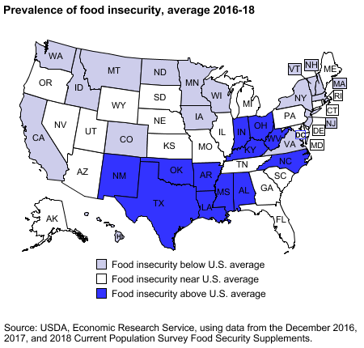
Americans are in grave danger... but from what?
With more people remaining home and eating out less, this can aggravate the conditions of those who are in areas of high food insecurity rates.
In 2017 the US food insecurity rate was 11.8% (ers.usda.gov).
Notes:
Kenny

Slide 5

Just wondering...
Questions
Are impoverished people being affected by COVID-19 disproportionately?
Which areas around us are more affected?
Which regions have higher mortality rates?
How will COVID-19 affect our economy, especially food insecurity in the future?
Motive
Understanding of how COVID-19 is and/or will impact the world around us
Notes:
Rachael

Slide 6
What do we believe?
Our main hypothesis:
We believe that COVID-19 infection and mortality rates will be elevated in counties with higher levels of food insecurities compared to counties with lower levels. Our hypothesis is based on the fact that food insecurity is a good indicator for local socioeconomic status, and is often associated with development of chronic conditions, and poor health in those local communities.
Our null-hypothesis:
There is no association between food insecurity and COVID-19 infection and mortality rates.
Notes:
Kenny

Slide 7
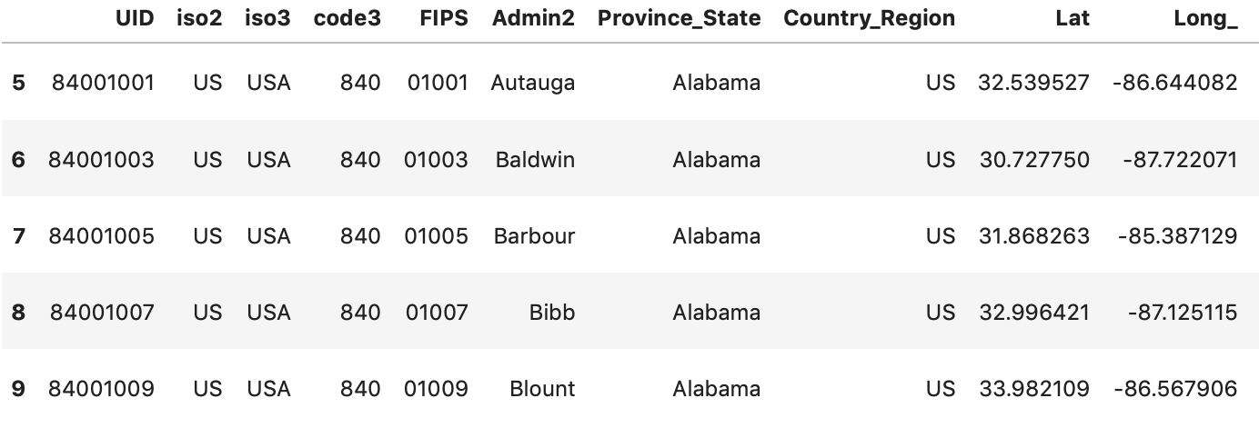
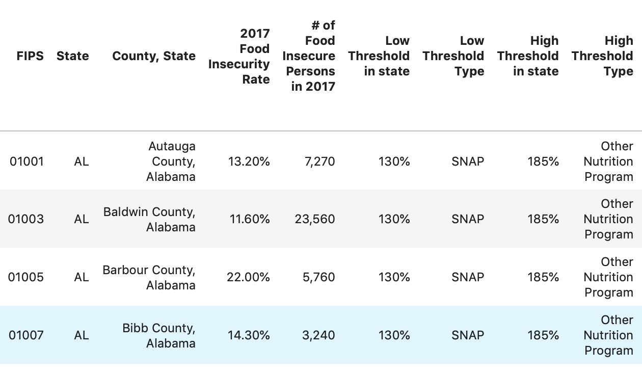
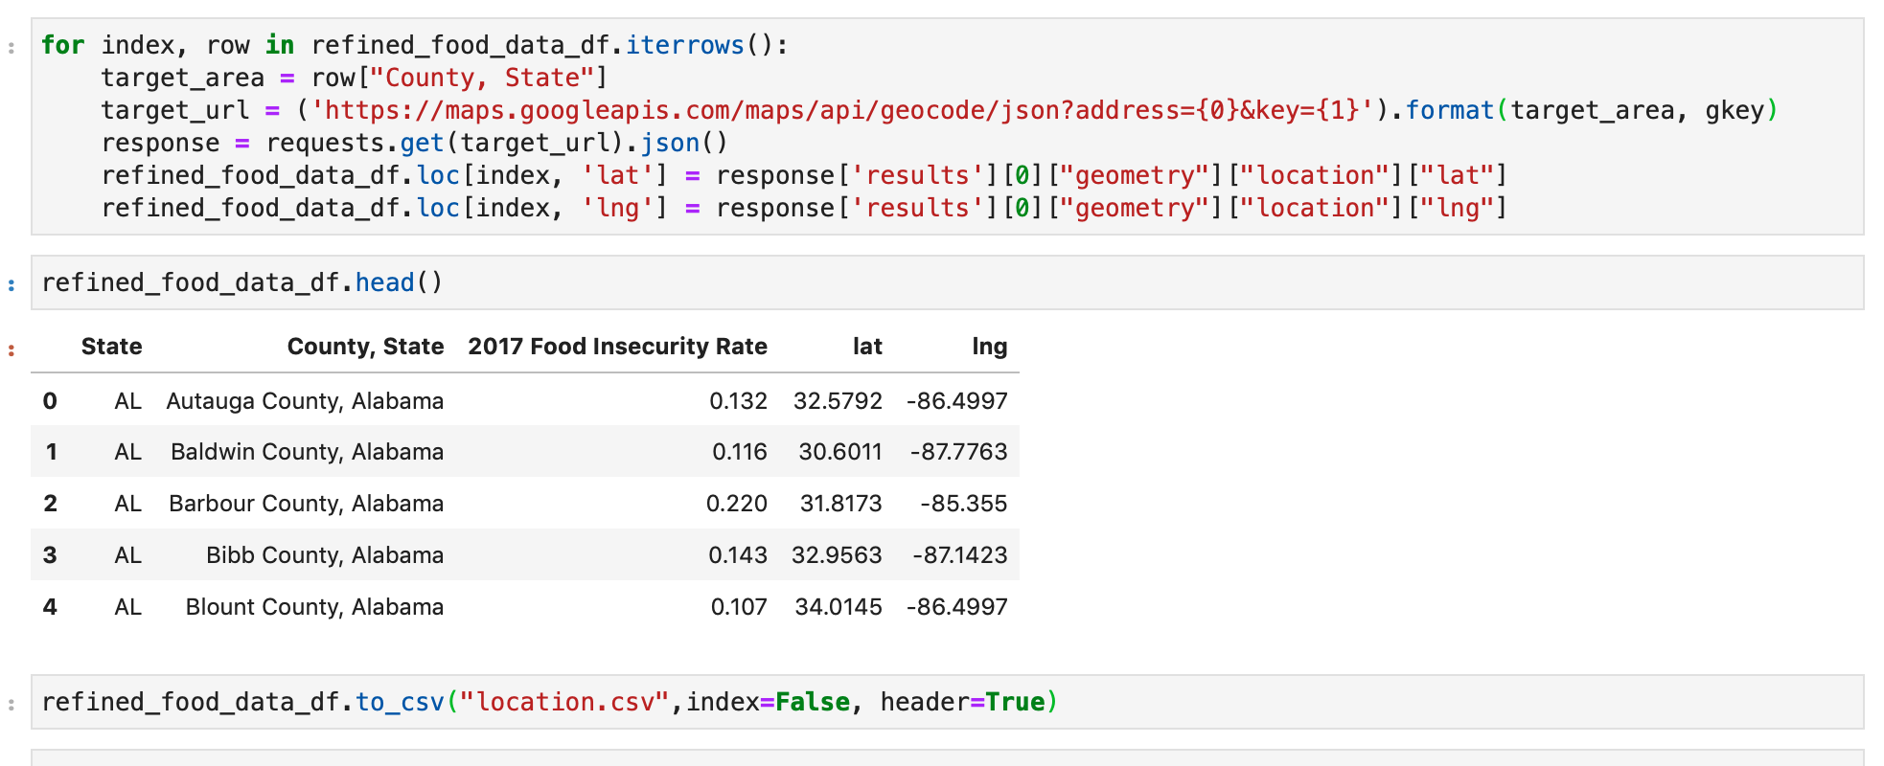
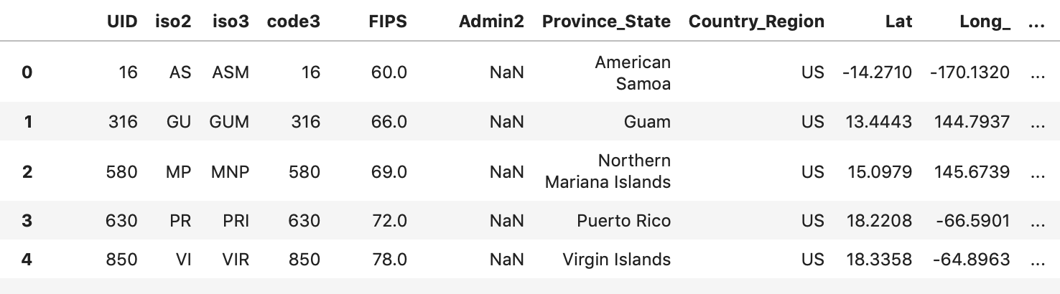
Data Exploration & Cleanup Process
Data Source
Food Insecurity Data
County_food_insecurity_2017.csv from Feeding America
Covid-19 Data:
time_series_covid19_confirmed_US.csv & time_series_covid19_deaths_US.csv from John Hopkins Univ.
Data Clean & Preparation
Drop empty, null, and unqualified records.
Geocode all US county to prepare for the heatmaps.
Notes:
Susan

Slide 8
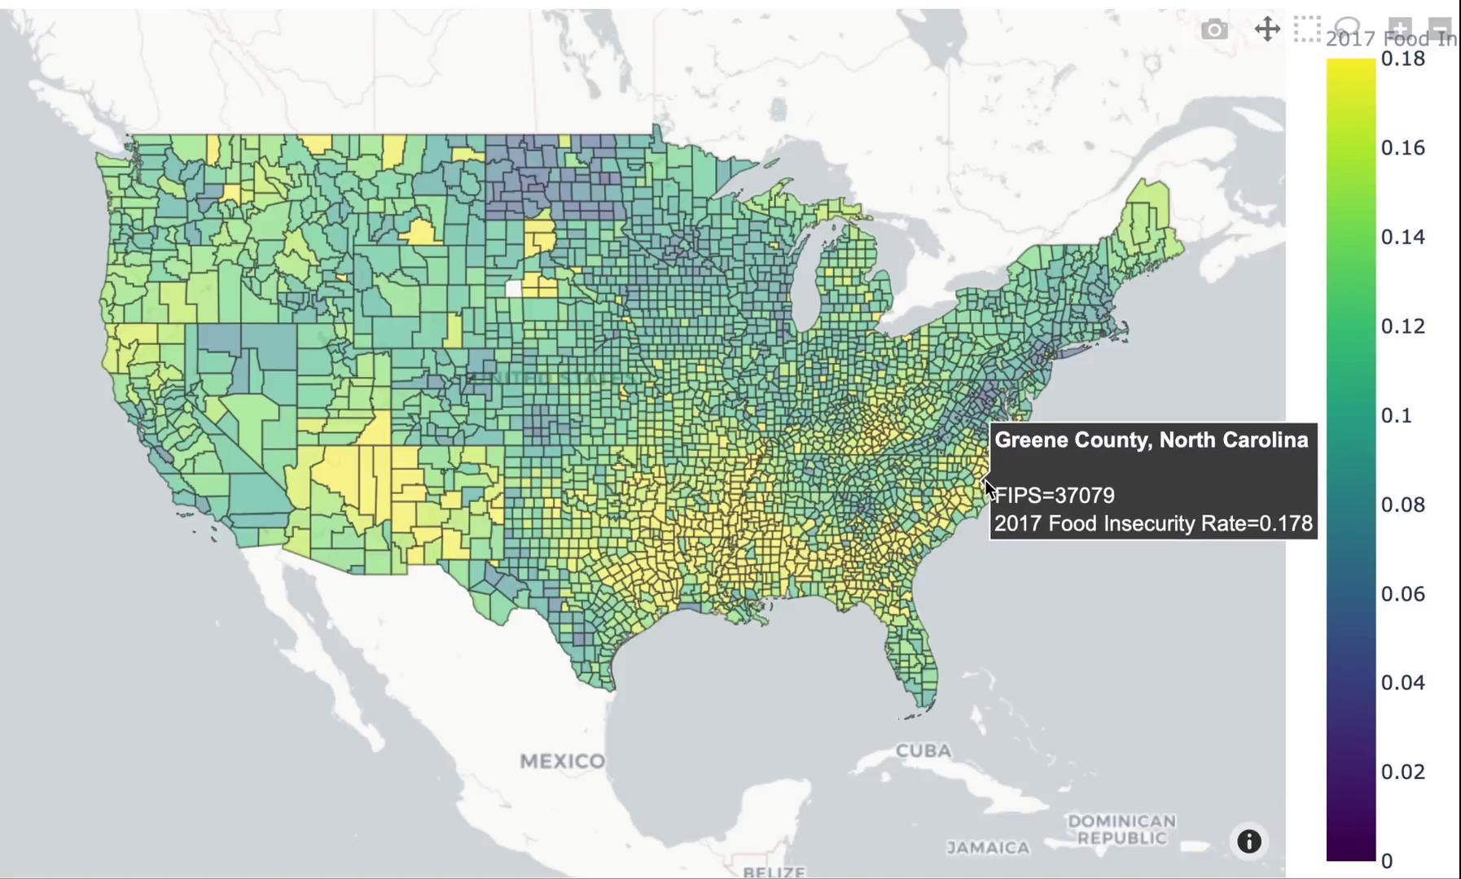
Data visualization through plotly: food insecurity
Food Insecurity at county level:
More than 3000 counties.
Yellow color represents counties
with food insecurity >= 18%
at population level.
Darker color represents lower
level of food insecurity.

Slide 9
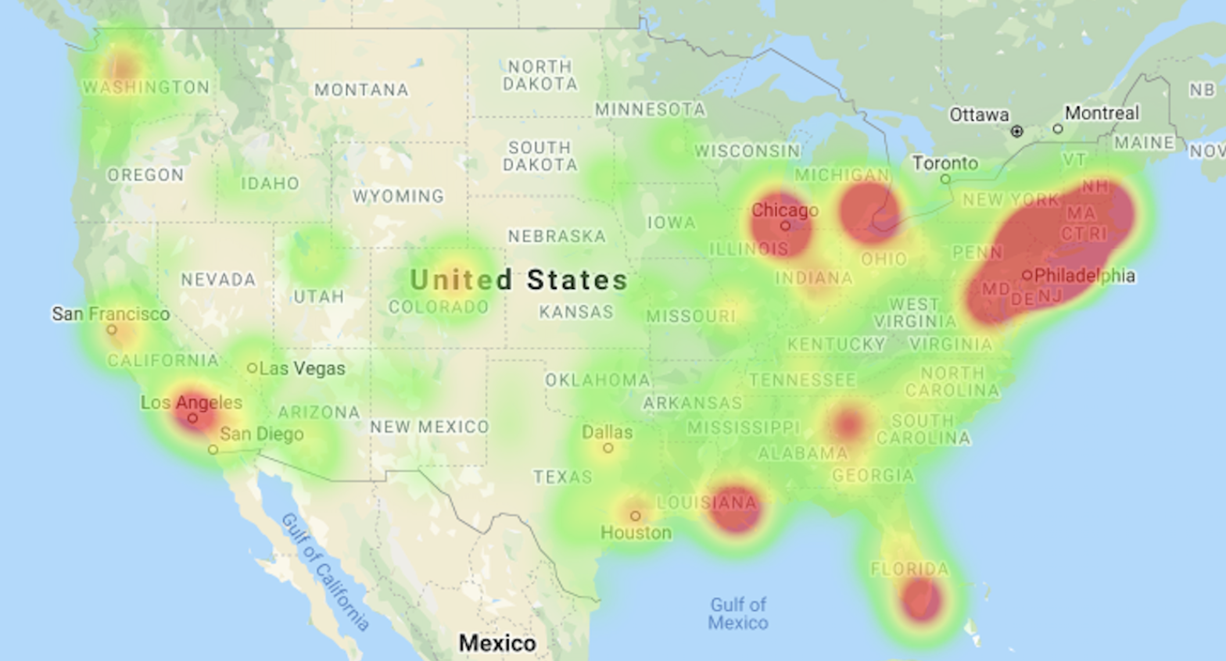
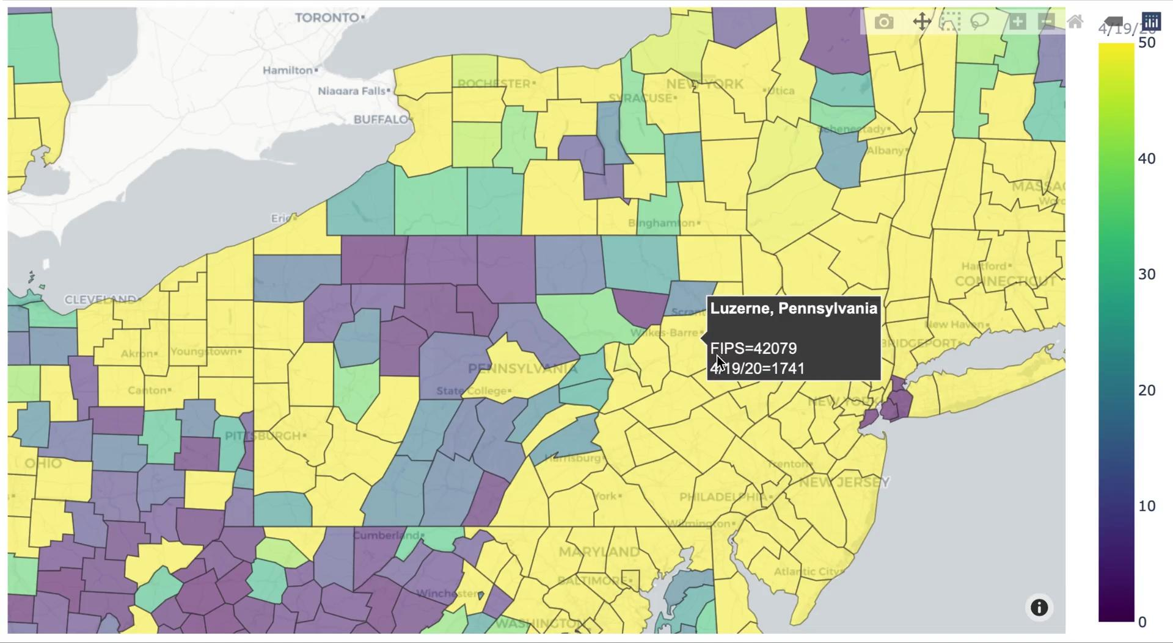
Actual number of people diagnosed with Covid-19: Two approaches
COVID19 Number of Infections confirmed

Slide 10
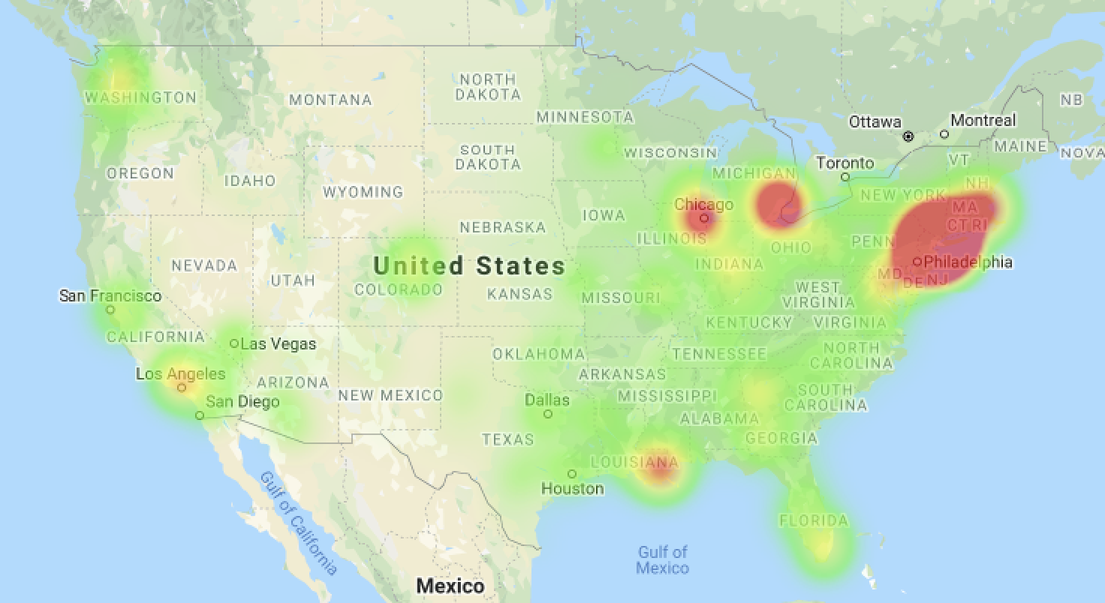
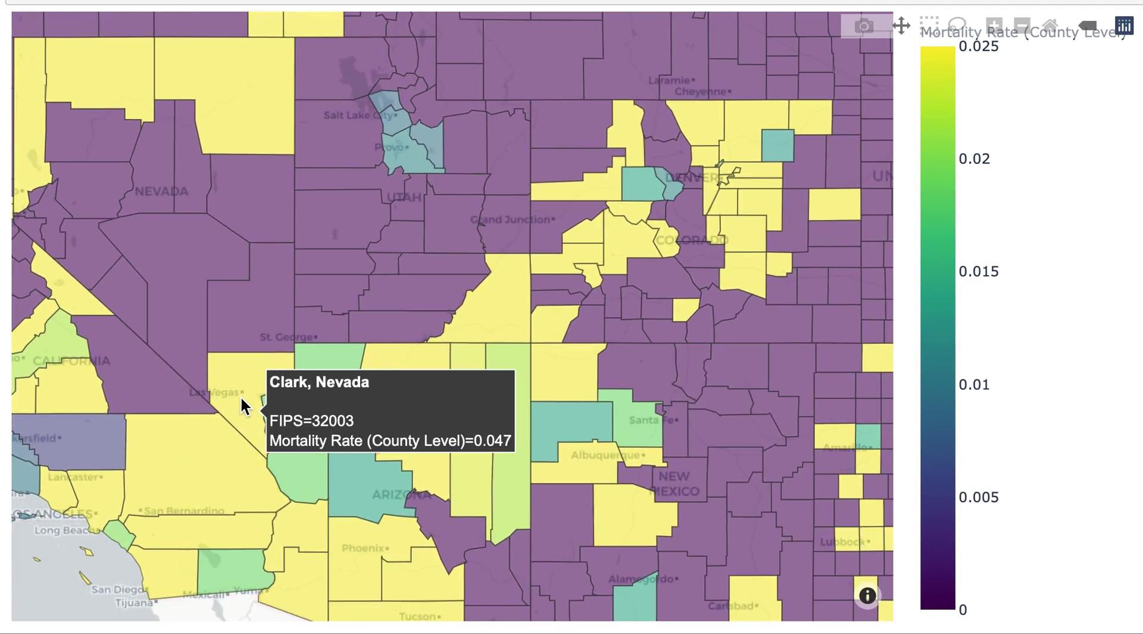
Actual number of people died due to Covid-19: Two approaches continued
Mortality rate among those infected
Number of death due to COVID-19

Slide 11
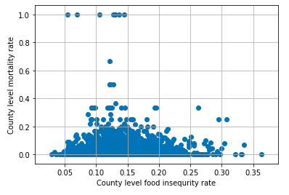
Regression analyses and results
Statistical methods:
For mortality rate and food insecurity rate at county level: a linear regression analyses.
For the actual number of people infected with COVID-19, we conducted separate Poisson regressions, stratified by number of infected people (cutoff point: n=150). The reason is that north part of the county has high infections because of population density, and south is more likely due to low socioeconomic status.
Results:
Linear regression:
Intercept | Slope | P-value | R-value | Stderr
0.023 | 0.039 | 0.224 | 0.022 | 0.032

Slide 12
Regression analyses and results continued
Results:
2. Poisson regression: log~linear relationship between count data (number of infected at county level vs food insecurity):
n <= 150 infected | Coef. | Std err | Z test statistic | P>|z| | 95% Confidence Intervals
Intercept | -0.82 | 0.074 | -11.1 | 0 | -0.97 | -0.68
Food insecurity | 4.06 | 0.504 | 8.0 | 0 | 3.07 | 5.05
n > 150 infected
Intercept | 9.32 | 0.004 | 2223.0 | 0 | 9.31 | 9.33
Food insecurity | 1.15 | 0.036 | 31.9 | 0 | 1.08 | 1.22

Slide 13
Conclusions Summary
We did not find statistically significant evidence for linear relationship between mortality rate due to COVID-19 and food insecurity rate at county level.
COVID-19 is rapidly evolving and any analyses are temporal and will need future validations.
We found that there are large geographical variations in the number of infected with COVID-19 as well as mortality.
In our stratified analyses, the evidence suggest that the northern part of the country’ population density is high, whereas south and midwest are suffering from poverty, and therefore, we observed stronger associations between food insecurity and COVID-19 infection rate when n<= 150 versus those with n >150 at county level.
Future updates and additional modelings are needed to improve the accuracy of this model.
Limitations: no person-level data, such as existing conditions, race/ethnicity, or age. Our analyses are restricted to county level associations.
Notes:
Jason

Slide 14
Sources:
John Hopkins University, Novel Coronavirus (COVID-19) Cases, GitHub repository, https://github.com/CSSEGISandData/COVID-19
Morrison, Rosanne M. “Food Security and Nutrition Assistance.” USDA ERS - Food Security and Nutrition Assistance, 12 Sept. 2019,
www.ers.usda.gov/data-products/ag-and-food-statistics-charting-the-essentials/food-security-and-nutrition-assistance/
“What Is Food Insecurity in America?” Hunger and Health, 2019, hungerandhealth.feedingamerica.org/understand-food-insecurity/.

